Slide 1

structure of Animal Cell
Dr.Dhuha Bahaa
1st.level
LAB (( 2))

Slide 2
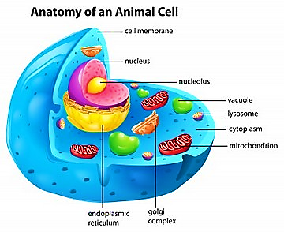
Structure of Animal Cell
Animal cell Definition:
Animal cells are eukaryotic, they have outer boundary known as the plasma membrane. The nucleus and the organelles of the cell are bound by a membrane. The genetic material (DNA) in animal cells is within the nucleus that is bound by a double membrane.

Slide 3
1- Cell membrane
* It is a semi-permeable barrier, allowing only a few molecules to move across it.
*Electron microscopic studies of cell membrane shows the lipid bi-layer model of the plasma membrane, it also known as the fluid mosaic model.

Slide 4
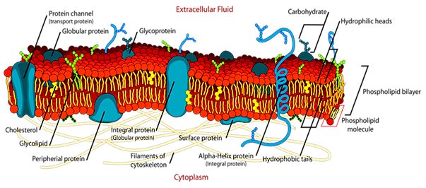
* The cell membrane is made up of phospholipids, which has polar (hydrophilic) heads and non-polar (hydrophobic) tails.

Slide 5
2- Cytoplasm
* The fluid matrix that fills the cell is the cytoplasm.
* The cellular organelles are suspended in this matrix of the cytoplasm.
* This matrix maintains the pressure of the cell, ensures the cell doesn't shrink or burst.

Slide 6
3- Nucleus
* Nucleus is the house for most of the cells genetic material- the DNA and RNA.
*The nucleus is surrounded by a porous membrane known as the nuclear membrane.
*The nucleus controls the activity of the cell and is known as the control center.

Slide 7
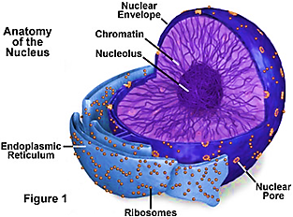
The nucleolus is the dark spot in the nucleus, and it is the location for ribosome formation.

Slide 8
4- Ribosomes
Ribosomes is the site for protein synthesis where the translation of the RNA takes place.
As protein synthesis is very important to the cell, ribosomes are found in large number in all cells.
Ribosomes are found freely suspended in the cytoplasm and are attached to the endoplasmic reticulum.

Slide 9
5- Endoplasmic reticulum
ER is the transport system of the cell. It transports molecules that need certain changes and also molecules to their destination.
ER is of two types, rough and smooth.

Slide 10
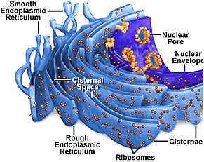
ER bound to the ribosomes appear rough and is the rough endoplasmic reticulum; while the smooth ER do not have the ribosomes.

Slide 11
6- Lysosomes
It is the digestive system of the cell.
They have digestive enzymes helps in breakdown the waste molecules and also help in detoxification of the cell.

Slide 12
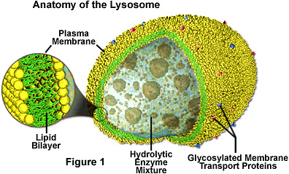
If the lysosomes were not membrane bound the cell could not have used the destructive enzymes.

Slide 13
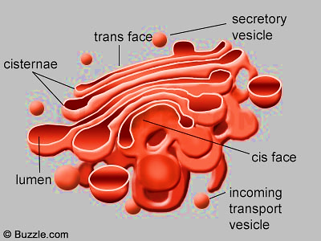
7- Golgi apparatus
Golgi bodies are the packaging center of the cell.
The Golgi bodies modify the molecules from the rough ER by dividing them into smaller units with membrane known as vesicles.
They are flattened stacks of membrane-bound sacs.

Slide 14
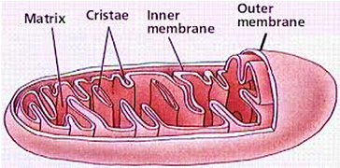
8 – Mitochondria
Mitochondria is the main energy source of the cell.
They are called the powerhouse of the cell

Slide 15
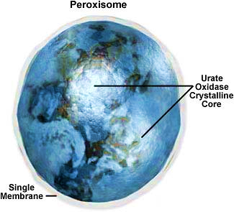
9 – Peroxisomes
Peroxisomes are single membrane bound organelle that contain oxidative enzymes that are digestive in function.
They help in digesting long chains of fatty acids and amino acids.

Slide 16
10 – Cytoskeleton
It is the network of microtubules and microfilament fibers.
They give structural support and maintain the shape of the cell.

Slide 17
11 - Cilia and Flagella
Cilia and flagella are structurally identical structures.
They are different based on the function they perform and their length.
Cilia are short, are in large number per cell while flagella are longer, and are fewer in number.
They are organelles of movement.
The flagella motion is undulating and wave-like whereas the ciliary movement is power stroke and recovery stroke.

Slide 18
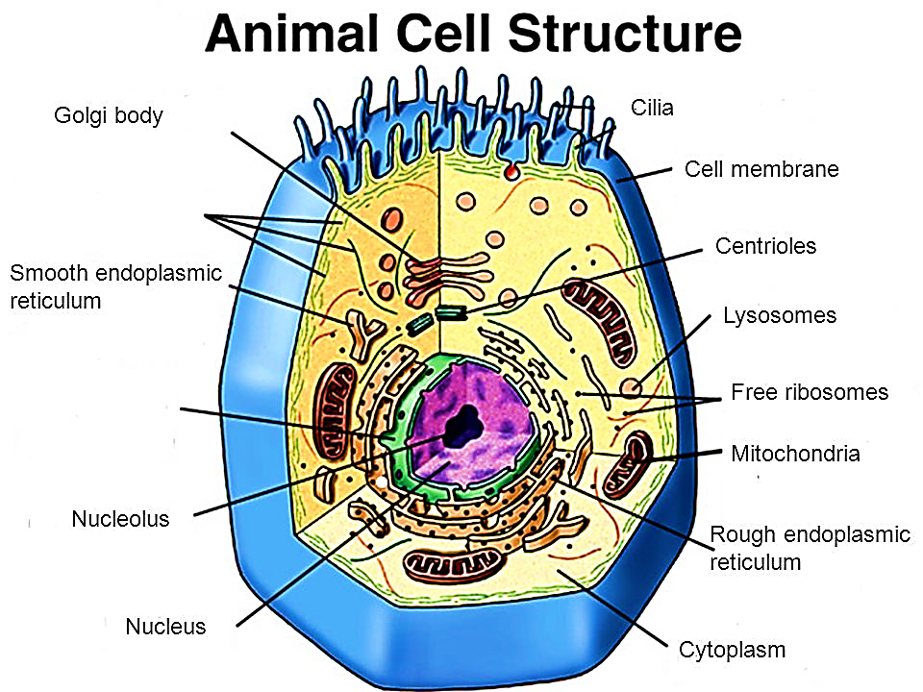

Slide 19
